Slide 1
UMD DATA605 - Big Data Systems Relational DBs
SQL Intro
SQL tutorial
Relational DB internals
Dr. GP Saggese
gsaggese@umd.edu
with thanks to Prof.
Alan Sussman
Amol Deshpande

Slide 2
UMD DATA605 - Big Data Systems Relational DBs
SQL Intro
SQL tutorial
Relational DB internals
Silbershatz: Chap 2

Slide 3
Relational Model: Overview
Introduced by Ted Codd (late 60's, early 70's)
First prototypes:
Ingres Project at Berkeley (1970-1985):
Ingres (INteractive Graphics REtrieval System) -> PostgreSQL (=Post Ingres)
Postgres -> Illustra -> Informix -> IBM
IBM System R (1970) -> Oracle, IBM DB2
Relational data model contributions
Formal semantics
Data independence: separation of logical and physical data models
Declarative query languages (e.g., SQL)
Query optimization
Key to commercial success

Slide 4
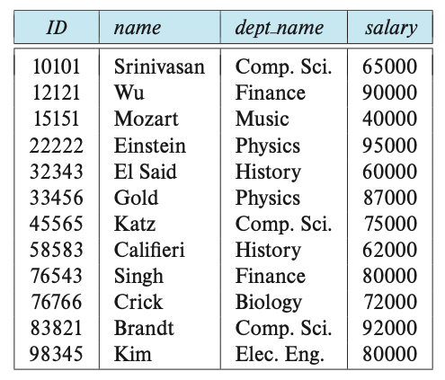
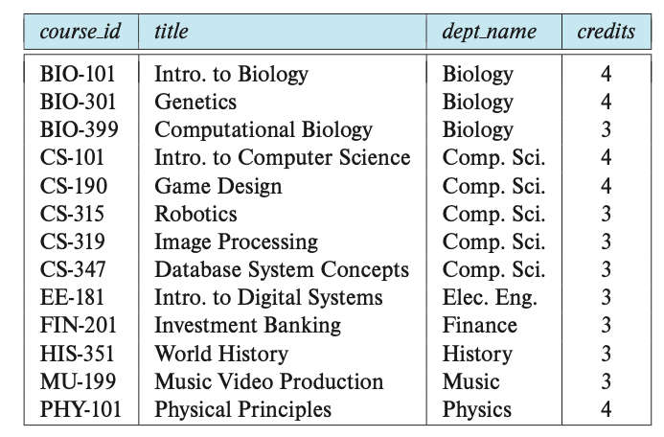
Relational Model: Key Definitions
A relational DB consists of a collection of tables (aka relations)
Each table has a unique name and a schema
Each row (aka tuple, record) in a table represents a relationship among a set of values
Each element of the row corresponds to a column (aka attribute)
Each element in a column is atomic (e.g., a phone number is a single object and not a sequence of numbers)
A valid value is `NULL` representing a value that is unknown or doesn’t exist (e.g., someone not having a phone number)
E.g., instructor and course relations
Relation schema
A list of attributes and their domains
Like type definition in programming languages
E.g., the domain of salary is integers >= 0
Instance of relation
A particular instantiation of a relation with actual values
Will change over time
instructor relation
course relation
Notes:
Chap 2

Slide 5
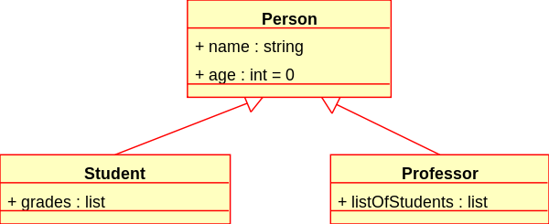
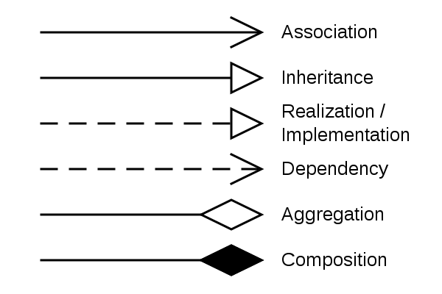

UML Class Diagram
UML class diagram
Used in OOP and DB design
UML = Unified Modeling Language
Diagram showing classes, attributes, methods, and relationships
Schema diagram
Each box is a relation
Attributes are listed inside the box
Primary keys
Foreign key constraints
Notes:
Chap 2

Slide 6
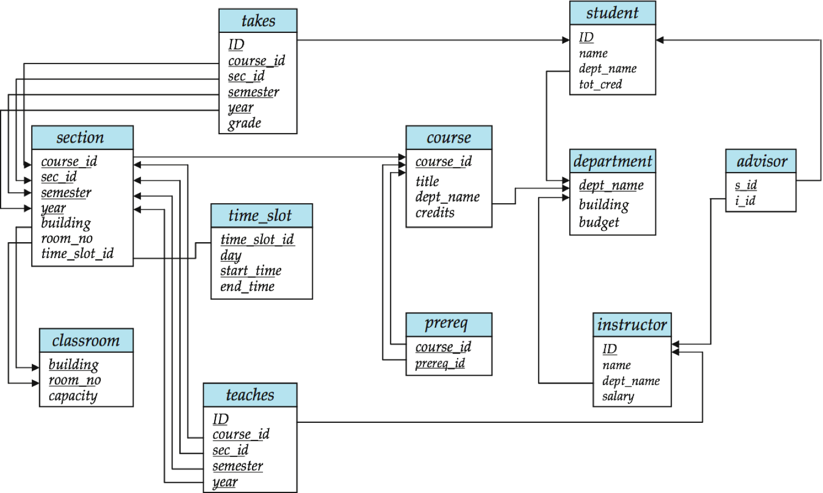
Example: University DB
Schema diagram of a DB representing University
Each box is a table / relation
Column / fields / attributes are listed inside the box
Primary keys: underlined fields
Foreign key constraints: arrows between boxes
Notes:
Schema diagram (schema + primary-key and foreign-key relation)
Each box is a relation with the name on top
The attributes are listed inside the box
Primary-key are underlined
Foreign-key relations are represented by arrows from (referencing to referenced relation)

Slide 7
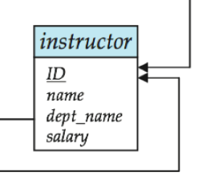
Primary Key
R is the set of attributes of a relation r
K is a superkey of R if values for K are sufficient to identify a unique tuple of each possible relation r(R)
E.g., {ID} and {ID,name} are both superkeys of instructor
{name} is not a superkey (or a key) of instructor
Superkey K is a candidate key if K is minimal
E.g., {ID} is a candidate key for instructor
One of the candidate keys is selected to be the primary key
Typically one that is small and immutable (doesn’t change often)
Primary keys typically are the first in the schema and highlighted / underlined
Would SSN be a primary key?
Primary key constraint: tuples in the relation can’t have the same primary key

Slide 8
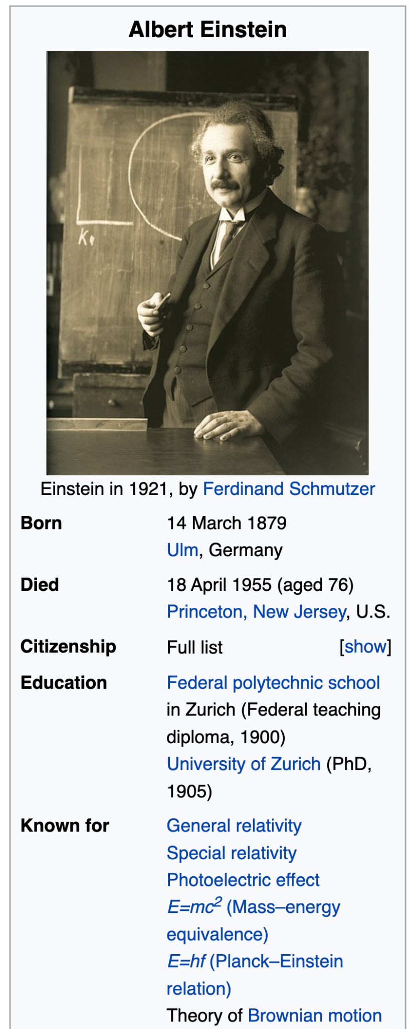
Exercise: What are Primary Keys?
Marital status
Married(person1_ssn, person2_ssn, date_married, date_divorced)
Bank account
Account(cust_ssn, account_number, cust_name, balance, cust_address)
Research assistantship at UMD
RA(student_id, project_id, supervisor_id, appt_time, appt_start_date, appt_end_date)
Information typically found on Wikipedia
Person(Name, Born, Died, Citizenship, Education, ...)
Info about US President on Wikipedia
President(name, start_date, end_date, vice_president, preceded_by, succeeded_by)
Tour de France: Historical Rider Participation Information
Rider(Name, Born, Team-name, Coach, Sponsor, Year)

Slide 9
Exercise: What are Primary Keys?
Marital status
Married(person1_ssn, person2_ssn, date_married, date_divorced)
Bank account
Account(cust_ssn, account_number, cust_name, balance, cust_address)
Research assistantship at UMD
RA(student_id, project_id, supervisor_id, appt_time, appt_start_date, appt_end_date)
Information typically found on Wikipedia
Person(Name, Born, Died, Citizenship, Education, ...)
Info about US President on Wikipedia
President(name, start_date, end_date, vice_president, preceded_by, succeeded_by)
Tour de France: Historical Rider Participation Information
Rider(Name, Born, Team-name, Coach, Sponsor, Year)

Slide 10
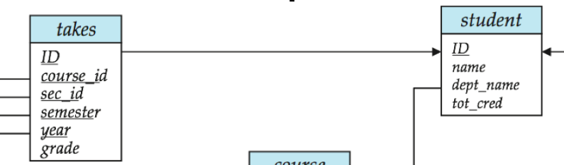
Foreign Key
Foreign key: primary key of a relation that appears in another relation
E.g., {ID} from student appears in takes, advisor
takes is the “referencing relation” (with the foreign key)
student called “referenced relation” (with the primary key)
Typically shown by an arrow from referencing to referenced relation
Foreign key constraint: the tuple corresponding to that primary key must exist, e.g.,
Tuple: ('student101', ‘DATA605’) in takes
But no tuple corresponding to 'student101' in student
Aka referential integrity constraint

Slide 11
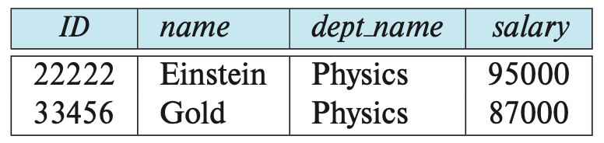

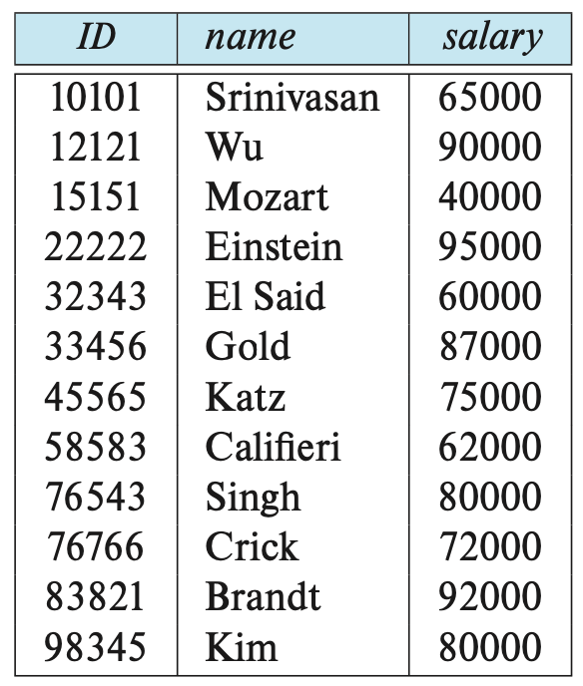

Relational Algebra
Relation: set of tuples (without replication)
Relational algebra: set operations that take one or more relations as input and produce a new relation, e.g.,
unary relation: select, project, rename
binary relation: union, Cartesian product, set difference
Selection: select tuples that satisfy a given predicate
E.g., select tuples of instructor where `dept_name = “Physics”
Projection: return tuples with a subset of attributes
E.g., project tuples of instructor with only (name, salary)
Set operations: union, intersection, set_difference of relations
Need to be compatible (i.e., have the same attributes and names)

Slide 12
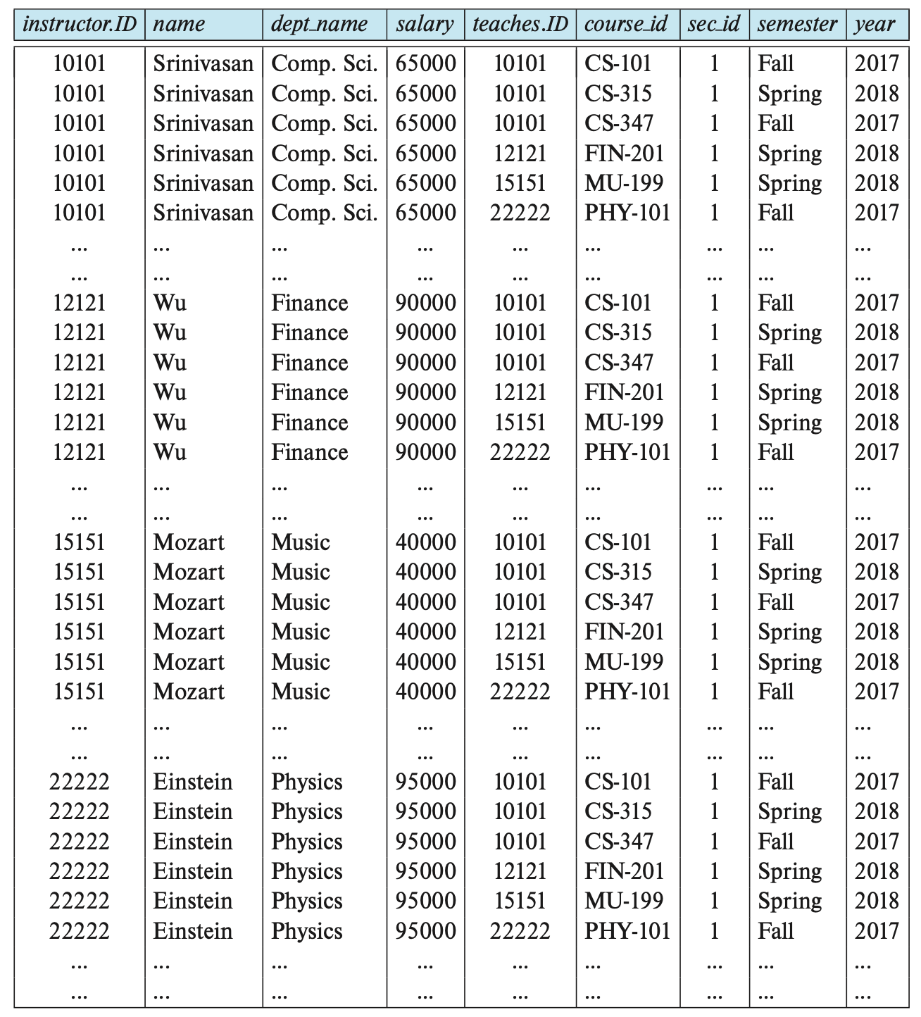
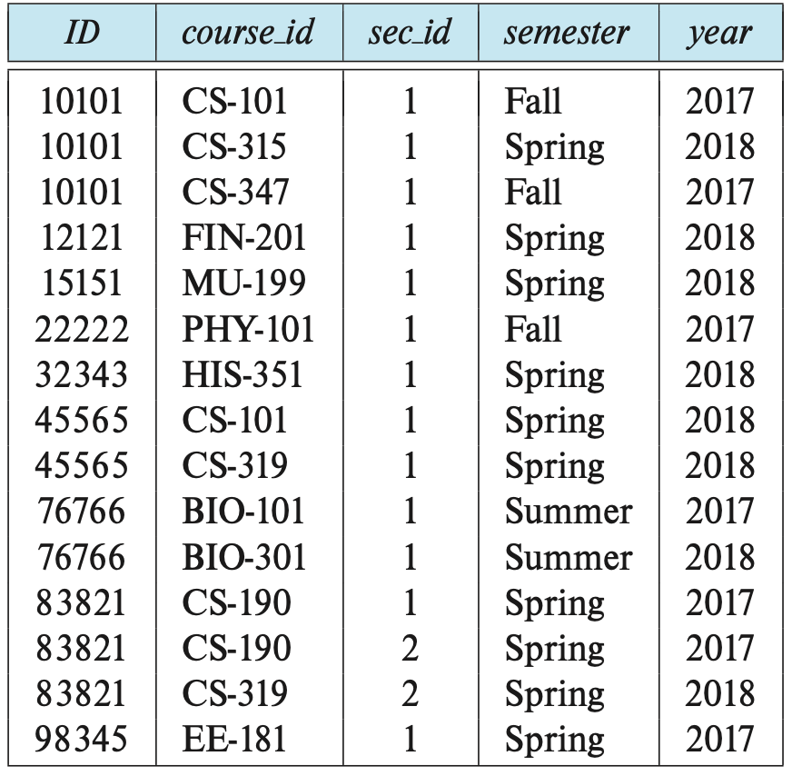

Relational Algebra
Cartesian product: combine information from two relations
E.g., `instructor` x `teaches`
`instructor = (ID, name, dept_name)` and `teaches = (ID, course_id, sec_id, semester, year)`
Gives `(instructor.ID, instructor.name, instructor.dept_name, teaches.ID, ...)`

Slide 13
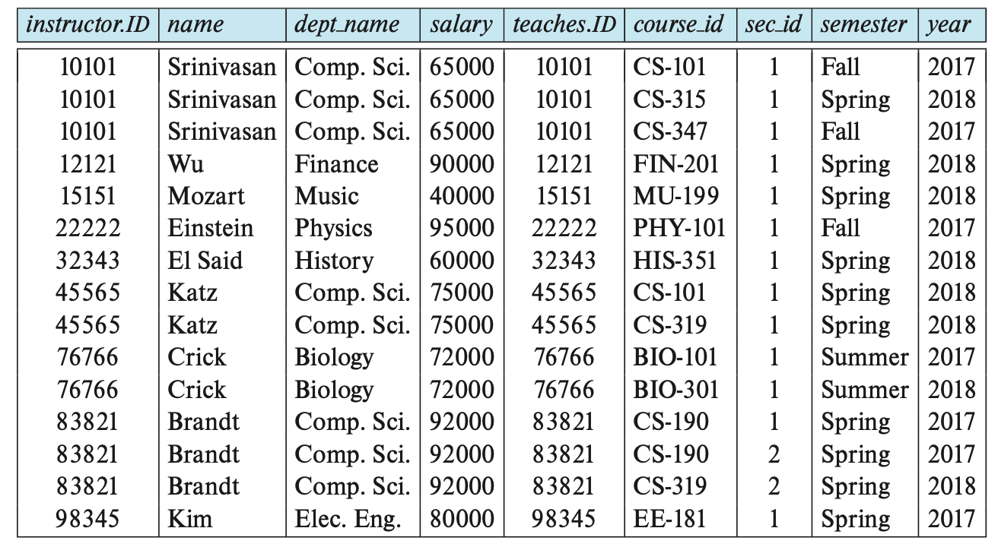
Relational Algebra
Join: Cartesian-product and then a selection based on equality between two fields
E.g., instructor.ID = teaches.ID

Slide 14
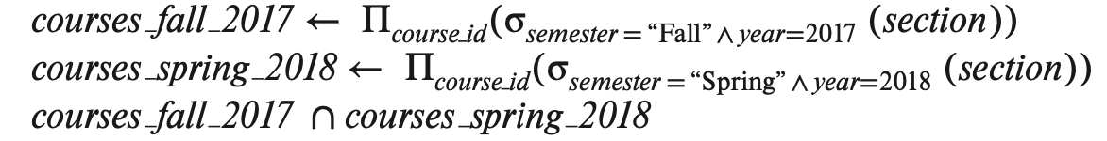
Relational Algebra
Query: combination of relational algebra operations
Assignment: assign parts of relational algebra to temporary relation variables
A query can be written as a sequential program
Equivalent queries: two queries that give the same result on any DB instance
Some formulation can be more efficient than others

Slide 15
SQL Overview
Relational Algebra: mathematical description of a language to manipulate Relations (aka Tables)
SQL
Programming language to describe and transform data in a Relational DB
Originally called Sequel
Name was changed to Structured Query Language
Data definition language (DDL)
Define schema of the data (e.g., tables, attributes, indices)
Specify integrity constraints (e.g., primary key, foreign key, not null)
Data modification language (DML)
Modify the data in tables
Insert
Update
Query data
Authorization
Specify security constraints
Define views
Control transactions
E.g., specify beginning and end, control isolation level

Slide 16
SQL Overview
Data description language
CREATE TABLE <name> ( <field> <domain>, ... )
Data modification language
INSERT INTO <name> (<field names>) VALUES (<field values>) DELETE FROM <name> WHERE <condition> UPDATE <name> SET <field name> = <value> WHERE <condition>
Query language
SELECT <fields> FROM <name> WHERE <condition>

Slide 17
Jupyter Notebook Tutorial
Jupyter utorial dir
Readme
Notebook to execute / study

Slide 18
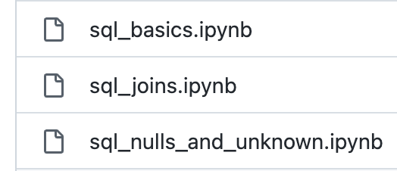
SQL Tutorial
SQL tutorial dir
Readme
Explains how to run the tutorial
Three notebooks in tutorial_university
How to learn from a tutorial
Reset the notebook
Execute each cell one at the time
Understand what each cell does
Look at the output
Change the code
Play with it
Build your mental model
Ideally create a new file and retype (!) everything

Slide 19
Create Table
CREATE TABLE r
(A_1 D_1,
A_2 D_2,
...
A_n D_n,
IntegrityConstraint_1,
IntegrityConstraint_n);
where:
r is name of table (aka relation)
A_i name of attribute (aka field, column)
D_i domain of attribute A_i
Constraints:
Primary key
Need to be all non-null and unique
PRIMARY KEY (A_j1, A_j2, ..., A_jn)
Foreign key
Values of attributes for any tuple in current relation must correspond to values of the primary key attributes of some tuple in relation s
FOREIGN KEY (A_k1, A_k2, ..., A_kn) REFERENCES s
Not null
Specify that null value is not allowed for that attribute
A_i D_i NOT NULL
SQL will prevent changes to the DB that violate any integrity constraint

Slide 20
Select
SELECT A_1, A_2, ..., A_n
FROM r_1, r_2, ..., r_m
WHERE P;
SELECT: select the attributes to list (i.e., projection)
FROM: list of tables to be accessed
Define a Cartesian product of the tables
The query is going to be optimized to avoid to enumerate tuples that will be eliminated
WHERE: predicate involving attributes of the relations in the FROM clause (i.e., selection)
In SELECT or WHERE clauses, might need to use the table names as prefix to qualify the attribute name
E.g., instructor.ID vs teaches.ID
A SELECT statement can be expressed in terms of relational algebra
Cartesian product -> selection -> projection
Difference: SQL allows duplicated values, relational algebra works with mathematical sets

Slide 21
Null values
An arithmetic operation with NULL yields NULL
Comparison with NULL
1 < NULL?
What about NOT(1 < NULL)?
SQL yields UNKNOWN when comparing with NULL value
There are 3 logical values: True, False, Unknown
Boolean operators
Can be extended according to common sense, e.g.,
True AND Unknown = Unknown
False AND Unknown = False
In a WHERE clause, if the result is Unknown it’s not included

Slide 22
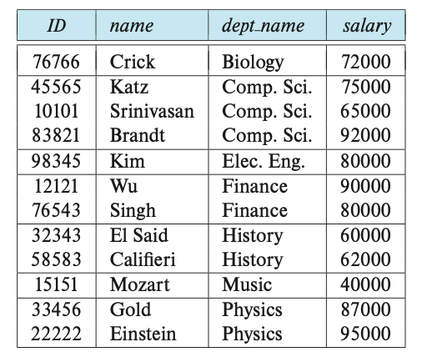
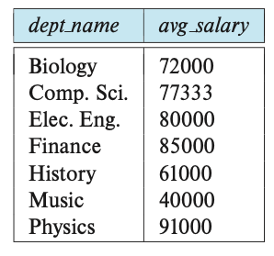
Group by Query
The attributes in GROUP BY are used to form groups
Tuples with the same value on all attributes are placed in one group
Any attribute that is not in the GROUP BY can appear in the SELECT clause only as argument of aggregate function
SELECT dept_name, AVG(salary)
FROM instructor
GROUP BY dept_name;
-- Error.
SELECT dept_name, salary
FROM instructor
GROUP BY dept_name;
salary is not in GROUP BY so it must be in an aggregate function

Slide 23
Having
State a condition that applies to groups instead of tuples (like WHERE)
Any attribute in the HAVING clause must appear in the GROUP BY clause
E.g., find departments with avg salary of instructors > $42k
SELECT dept_name, AVG(salary) AS avg_salary
FROM instructor
GROUP BY dept_name
HAVING AVG(salary) > 42000;
How does it work
FROM is evaluated to create a relation
(optional) WHERE is used to filter
GROUP BY collects tuples into groups
(optional) HAVING is applied to each group and groups are filtered
SELECT generates tuples of the results, applying aggregate functions to get a single result for each group

Slide 24
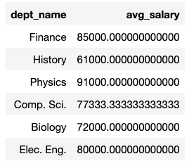
Nested subqueries
SQL allows to use the result of a query in another query
E.g., one can use a subquery returning only one attribute (aka scalar subquery) in any place a value is used
E.g., use the result of a query for set membership in the WHERE clause
E.g., use the result of a query in a FROM clause
SELECT tmp.dept_name, tmp.avg_salary
FROM (SELECT dept_name, AVG(salary) AS avg_salary
FROM instructor
GROUP BY dept_name) AS tmp
WHERE avg_salary > 42000

Slide 25

With
WITH clause allows to define a temporary relation containing the results of a subquery
It can be equivalent to a nested subqueries, but clearer
Find department with the maximum budget.
WITH max_budget(value) as (
SELECT MAX(budget) FROM department)
SELECT department.dept_name, budget
FROM department, max_budget
WHERE department.budget = max_budget.value

Slide 26
Delete
One can delete tuples using a query returning entire rows of a table
DELETE FROM r WHERE p
where:
r is a relation
P is a predicate
Remove all tuples (but not the table)
DELETE FROM instructor

Slide 27
Insert
To insert data into a relation we can specify tuples to insert
Tuples
INSERT INTO course VALUES (‘DATA-605’, ‘Big data systems’, ‘Comp. Sci.’, 4)
INSERT INTO course(course_id, title, dept_name, credits) VALUES (‘DATA-605’, ‘Big data systems’, ‘Comp. Sci.’, 4)
Query whose results is a set of tuples
INSERT INTO instructor (
SELECT ID, name, dept_name, 18000
FROM student
WHERE dept_name = ‘Music’ AND tot_cred > 144)
Nested queries are evaluated and then inserted so this doesn’t create infinite workload
INSERT INTO student (SELECT * FROM student)
Many DB have bulk loader utilities to insert a large set of tuples into a relation, reading from formatted text files
This is much faster than INSERT statements

Slide 28
Update
SQL can change a value in a tuple without changing all the other values
E.g., increase salary of all instructors by 5%
UPDATE instructor
SET salary = salary * 1.05
E.g., conditionally
UPDATE instructor
SET salary = salary * 1.05
WHERE salary < 70000
Nesting is allowed
UPDATE instructor
SET salary = salary * 1.05
WHERE salary < (SELECT AVG(salary) FROM instructor)

Slide 29
UMD DATA605 - Big Data Systems Movie Database Example (Optional)

Slide 30
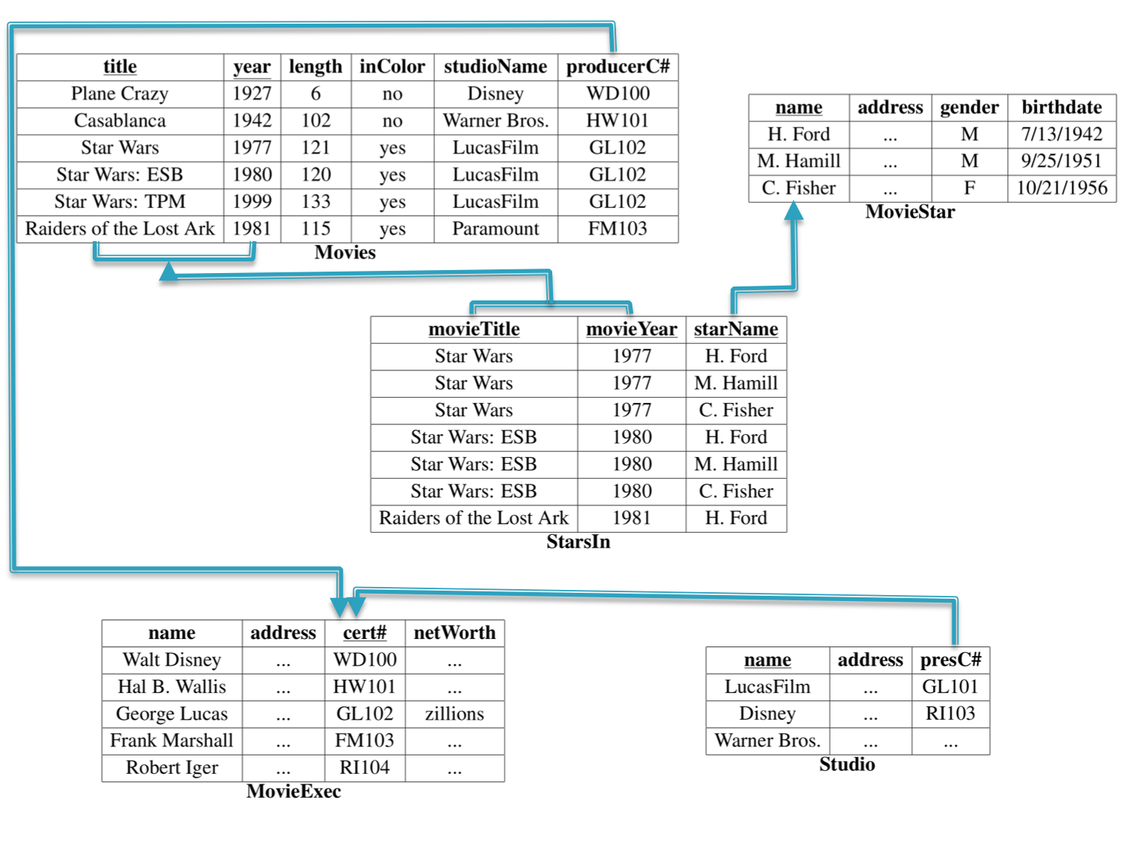
Example Schema for SQL Queries
Movie(title, year, length, inColor, studioName, producerC#)
StarsIn(movieTitle, movieYear, starName)
MovieStar(name, address, gender, birthdate)
MovieExec(name, address, cert#, netWorth)
Studio(name, address, presC#)

Slide 31
SQL: Data Definition
CREATE TABLE
Must define movieExec before movie. Why?
CREATE TABLE movieExec ( name char(30), address char(100), cert# integer primary key, networth integer); CREATE TABLE movie ( title char(100), year integer, length integer, inColor smallint, studioName char(20), producerC# integer references movieExec(cert#) );

Slide 32
SQL: Data Manipulation
INSERT
INSERT INTO StarsIn values('King Kong', 2005, 'Naomi Watts'); INSERT INTO StarsIn(starName, movieTitle, movieYear) values('Naomi Watts', 'King Kong', 2005);
DELETE
DELETE FROM movies WHERE movieYear < 1980;
Syntax is fine, but this command will be rejected. Why?
DELETE FROM movies WHERE length < (
SELECT avg(length) FROM movies);
Problem: as we delete tuples, the average length changes
Solution:
First, compute avg length and find all tuples to delete
Next, delete all tuples found above (without recomputing avg or retesting the tuples)

Slide 33
SQL: Data Manipulation
UPDATE
Increase all movieExec netWorth's over $100,000 by 6%, all other accounts receive 5%
Write two update statements:
UPDATE movieExec SET netWorth = netWorth * 1.06 WHERE netWorth > 100000; UPDATE movieExec SET netWorth = netWorth * 1.05 WHERE netWorth <= 100000;
The order is important
Can be done better using the case statement
UPDATE movieExec SET netWorth = CASE WHEN netWorth > 100000 THEN netWorth * 1.06 WHEN netWorth <= 100000 THEN netWorth * 1.05 END;

Slide 34
SQL Single Table Queries
Movies produced by Disney in 1990: note the rename
SELECT m.title, m.year FROM movie m WHERE m.studioname = 'disney' AND m.year = 1990;
The SELECT clause can contain expressions
SELECT title || ' (' || to_char(year) || ')' AS titleyear SELECT 2014 - year
The WHERE clause support a large number of different predicates and combinations thereof
year BETWEEN 1990 and 1995 title LIKE 'star wars%' title LIKE 'star wars _'

Slide 35
Single Table Queries
Find distinct movies sorted by title
SELECT DISTINCT title FROM movie WHERE studioname = 'disney' AND year = 1990 ORDER by title;
Average length of a movie
SELECT year, avg(length) FROM movie GROUP BY year;
GROUP BY: is a very important concept that shows up in many data processing platforms
What it does:
Partition the tuples by the group attributes (year in this case)
Do something (compute avg in this case) for each group
Number of resulting tuples == number of groups

Slide 36
Single Table Queries
Find movie with the maximum length
SELECT title, year FROM movie where movie.length = (select max(length) from movie);
The smaller "subquery" is called a "nested subquery”
Find movies with at most 5 stars: an example of a correlated subquery
SELECT * FROM movies m WHERE 5 >= (SELECT count(*) FROM starsIn si WHERE si.title = m.title AND si.year = m.year);
The "inner" subquery counts the number of actors for that movie.

Slide 37
Single Table Queries
Rank movies by their length
SELECT title, year, (SELECT count(*) FROM movies m2 WHERE m1.length <= m2.length) AS rank FROM movies m1;
Key insight: A movie is ranked 5th if there are exactly 4 movies with longer length.
Most database systems support some sort of a rank keyword for doing this
The above query doesn't work in presence of ties, etc.
Set operations
SELECT name FROM movieExec union/intersect/minus SELECT name FROM movieStar

Slide 38
Single Table Queries
Set Comparisons
SELECT * FROM movies WHERE year IN [1990, 1995, 2000]; SELECT * FROM movies WHERE year NOT IN ( SELECT EXTRACT(year from birthdate) FROM MovieStar );

Slide 39
Multi-table Queries
Key:
Do a join to get an appropriate table
Use the constructs for single-table queries
You will get used to doing all at once
Examples:
SELECT title, year, me.name AS producerName FROM movies m, movieexec me WHERE m.producerC# = me.cert#;

Slide 40
Multi-table Queries
Consider the query:
select title, year, producerC#, count(starName) from movies, starsIn where title = starsIn.movieTitle and year = starsIn.movieYear group by title, year, producerC#
What about movies with no stars?
Need to use outer joins
select title, year, producerC#, count(starName) from movies left outer join starsIn on title = starsIn.movieTitle and year = starsIn.movieYear group by title, year, producerC#
All tuples from 'movies' that have no matches in starsIn are included with NULLs
So if a tuple (m1, 1990) has no match in starsIn, we get (m1, 1990, NULL) in the result
The count(starName) works correctly then
Note: count(*) would not work correctly (NULLs can have unintuitive behavior)

Slide 41
Other SQL Constructs
Views
create view DisneyMovies select * from movie m where m.studioname = 'disney’;
Can use it in any place where a table name is used
Views are used quite extensively to: (1) simplify queries, (2) hide data (by giving users access only to specific views)
Views may be materialized or not

Slide 42
Other SQL Constructs
NULLs
Value of any attribute can be NULL
Because: value is unknown, or it is not applicable, or hidden, etc.
Can lead to counterintuitive behavior
For example, the following query does not return movies where length = NULL
select * from movies where length>= 120 or length<= 120
Aggregate operations can be especially tricky
Transactions
A transaction is a sequence of queries and update statements executed as a single unit
For example, transferring money from one account to another
Both the deduction from one account and credit to the other account should happen, or neither should
Triggers
A trigger is a statement that is executed automatically by the system as a side effect of a modification to the database

Slide 43
Other SQL Constructs
Integrity Constraints
Predicates on the database that must always hold
Key Constraints: Specifying something is a primary key or unique
CREATE TABLE customer ( ssn CHAR(9) PRIMARY KEY, cname CHAR(15), address CHAR(30), city CHAR(10), UNIQUE (cname, address, city));
Attribute constraints: Constraints on the values of attributes
bname char(15) not null
balance int not null, check (balance>= 0)

Slide 44
Integrity Constraints
Referential integrity: prevent dangling tuples
CREATE TABLE branch(
bname CHAR(15) PRIMARY KEY,
...); CREATE TABLE loan(...,
FOREIGN KEY bname REFERENCES branch);
Can tell the system what to do if a referenced tuple is being deleted

Slide 45
Integrity Constraints
Global Constraints
Single-table
CREATE TABLE branch (..., bcity CHAR(15), assets INT, CHECK (NOT(bcity = ‘Bkln’) OR assets>5M))
Multi-table
CREATE ASSERTION loan-constraint CHECK (NOT EXISTS ( SELECT* FROM loan AS L WHERE NOT EXISTS( SELECT* FROM borrower B, depositor D, account A WHERE B.cname = D.cname AND D.acct_no = A.acct_no AND L.lno= B.lno)))

Slide 46
Additional SQL Constructs
Select subquery factoring
To allow assigning a name to a subquery, then use its result by referencing that name
with temp as ( select title, avg(length) from movies group by year) select count(*) from temp;
Can have multiple subqueries (multiple with clauses)
Real advantage is when subquery needs to be referenced multiple times in main select
Helps with complex queries, both for readability and maybe performance (can cache subquery results)

Slide 47
Another SQL Construct
Select having clause
Used in combination with group by to restrict the groups of returned rows to only those where condition evaluates to true
select year, count(*) from movies where year > 1980 group by year having count(*) > 10;
Difference from where clause is that it applies to summarized group records, and where applies to individual records

